Slide 1
WhatsTheMove
Sam Rands and Zion Steiner

Slide 2
Overview
Goal: write a game-agnostic AI engine for perfect information games
Game-Agnostic: works for any suitable game
Perfect Info: all players know each game state
Solution: Minimax Algorithm

Slide 3
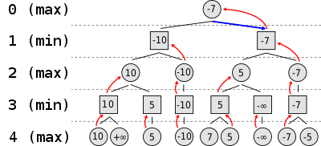
Minimax
Search each game state
Find the best worst-case end-of-game scenario
Maximize your success
Minimize enemy success

Slide 4
Design
Game has logic, state, players
Players return moves to make
EnginePlayer owns an engine
Engines calculate best move to make

Slide 5
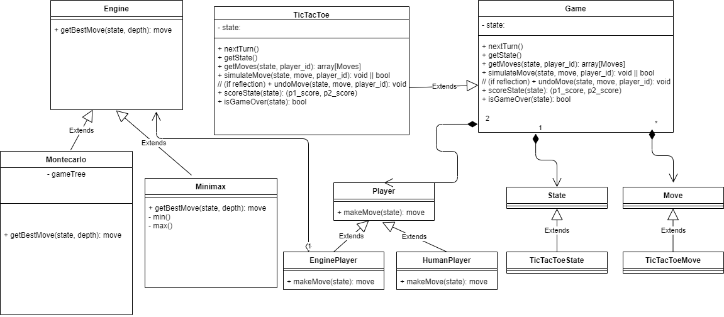
Design

Slide 6
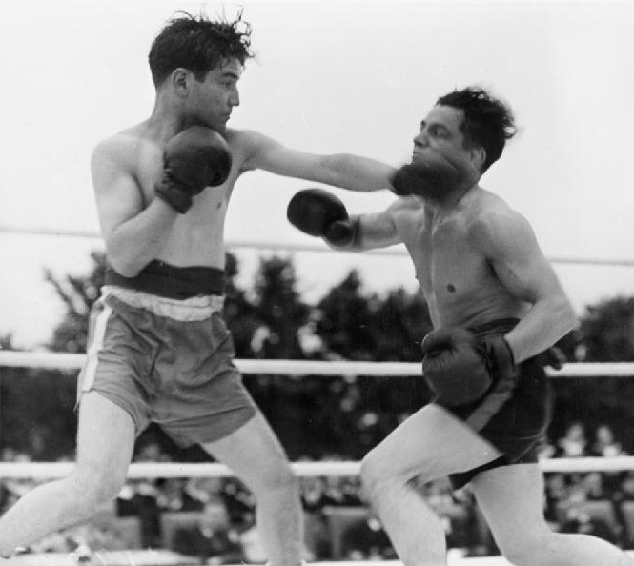
Test Setup
Minimax vs Minimax: what will happen?

Slide 7
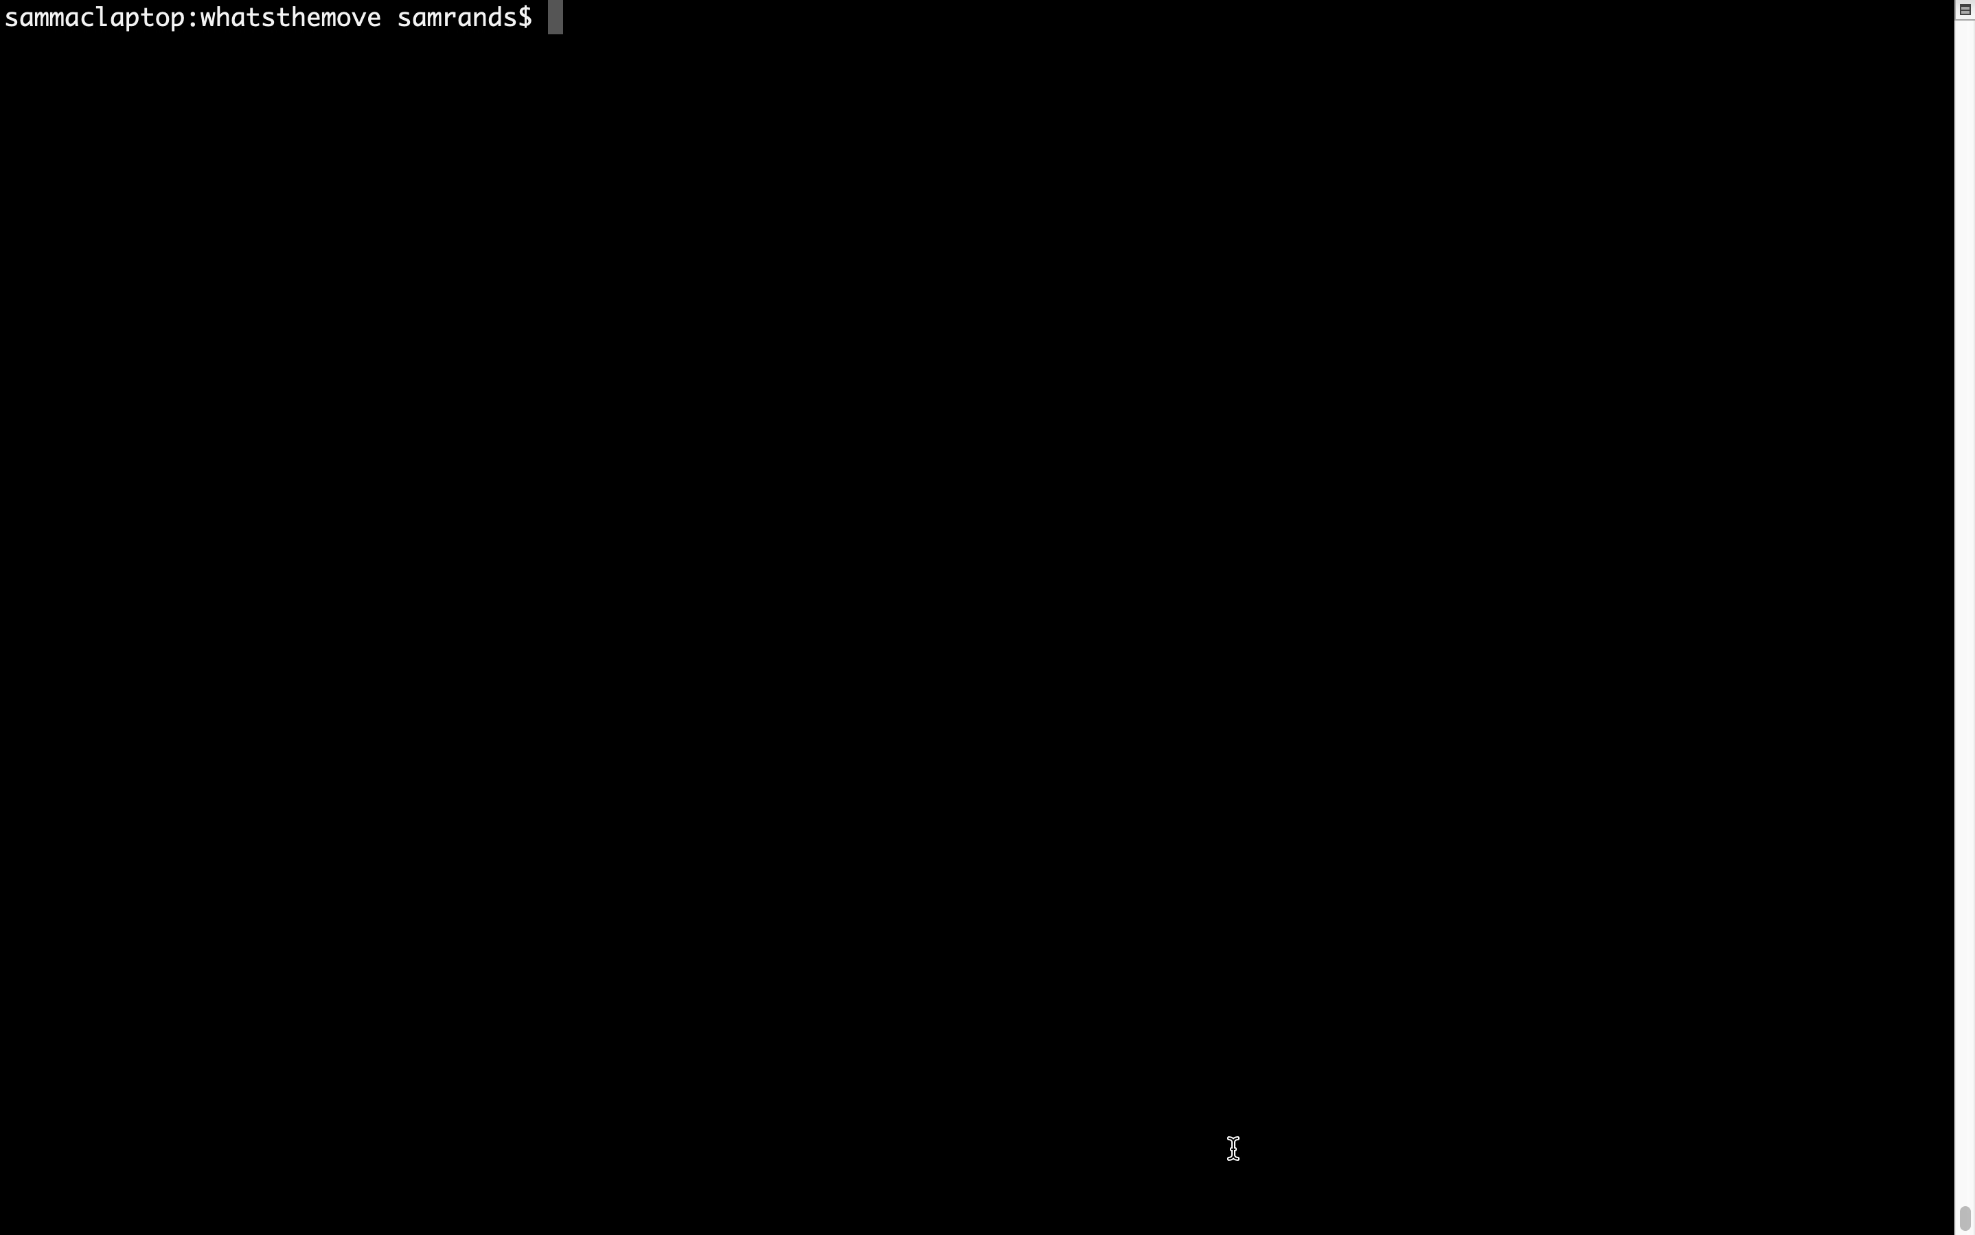
Demo

